Slide 1
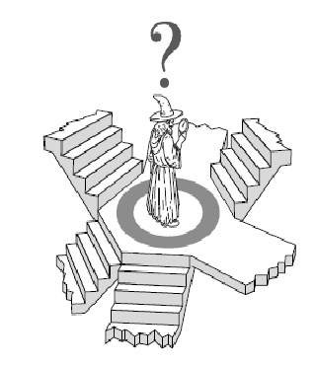
Lecture 03 – Part A Local Search
Dr. Shazzad Hosain
Department of EECS
North South Universtiy
shazzad@northsouth.edu

Slide 2
Beyond IDA* …
So far: systematic exploration: O(b^{d})
Explore full search space (possibly) using pruning (A*, IDA* … )
Best such algorithms (IDA*) can handle
10¹⁰⁰ states ≈ 500 binary-valued variables
but. . . some real-world problem have 10,000 to 100,000 variables 10^{30,000} states
We need a completely different approach:
Local Search Methods or Iterative Improvement Methods
‹#›

Slide 3
Local Search Methods
Applicable when seeking Goal State & don't care how to get there. E.g.,
N-queens,
map coloring,
finding shortest/cheapest round trips (TSP)
VLSI layout, planning, scheduling, time-tabling, . . .
resource allocation
protein structure prediction
genome sequence assembly
‹#›

Slide 4
Local Search Methods
Key Idea

Slide 5
Local search
Key idea (surprisingly simple):
Select (random) initial state (generate an initial guess)
Make local modification to improve current state (evaluate current state and move to other states)
Repeat Step 2 until goal state found (or out of time)
‹#›

Slide 6
Local Search: Examples
TSP

Slide 7
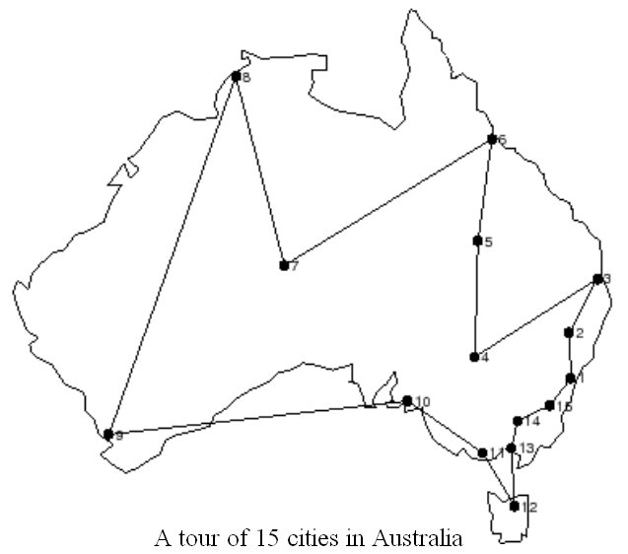
Traveling Salesman Person
Find the shortest Tour traversing all cities once.
‹#›

Slide 8
Traveling Salesman Person
A Solution: Exhaustive Search
(Generate and Test) !!
The number of all tours
is about (n-1)!/2
If n = 36 the number is about:
566573983193072464833325668761600000000
Not Viable Approach !!
‹#›

Slide 9
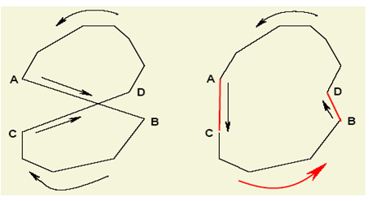
Traveling Salesman Person
A Solution: Start from an initial solution and improve using local transformations.
‹#›

Slide 10
2-opt mutation (2-Swap) for TSP
Choose two edges at random
‹#›

Slide 11
2-opt mutation for TSP
Choose two edges at random
‹#›

Slide 12
2-opt mutation for TSP
Remove them
‹#›

Slide 13
2-opt mutation for TSP
Reconnect in a different way (there is only one valid new way)
Continue until there is no 2-opt mutation
‹#›
Can be generalized as 3-opt (two valid ways), k-opt etc.

Slide 14
Local Search: Examples
N-Queens

Slide 15
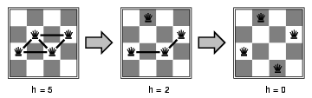
Example: 4 Queen
States: 4 queens in 4 columns (256 states)
Operators: move queen in column
Goal test: no attacks
Evaluation: h(n) = number of attacks
Not valid initial solution
‹#›

Slide 16
Local Search: Examples
Graph-Coloring

Slide 17
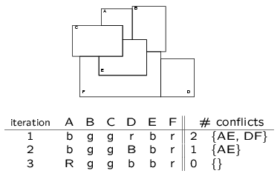
Example: Graph Coloring
Start with random coloring of nodes
Change color of one node to reduce # of conflicts
Repeat 2
‹#›

Slide 18
Local Search Algorithms
Basic idea: Local search algorithms operate on a single state – current state – and move to one of its neighboring states.
The principle: keep a single "current" state, try to improve it
Therefore: Solution path needs not be maintained.
Hence, the search is “local”.
Two advantages
Use little memory.
More applicable in searching large/infinite search space. They find reasonable solutions in this case.
‹#›

Slide 19
Local Search Algorithms
Hill Climbing,
Simulated Annealing,
Tabu Search

Slide 20

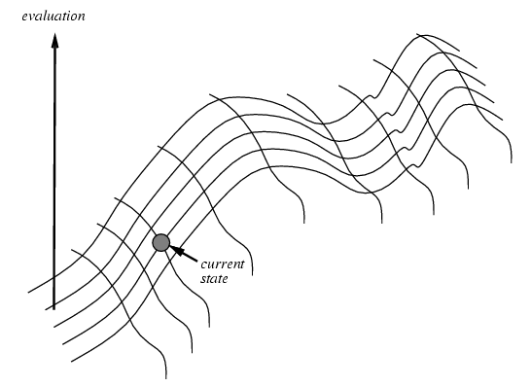
Hill Climbing
"Like climbing Everest in thick fog with amnesia"
Hill climbing search algorithm (also known as greedy local search) uses a loop that continually moves in the direction of increasing values (that is uphill).
It teminates when it reaches a peak where no neighbor has a higher value.
‹#›

Slide 21
Hill Climbing
evaluation
states
‹#›

Slide 22
Hill Climbing
Initial state … Improve it … using local transformations (perturbations)
‹#›

Slide 23
Hill Climbing
Steepest ascent version
function HILL-CLIMBING(problem) returns a solution state
inputs: problem, a problem
static: current, a node
next, a node
current 🡨 MAKE-NODE(INITIAL-STATE[problem])
loop do
next 🡨 a highest-valued successor of current
if VALUE[next] ≤ VALUE[current] then return current
current 🡨 next
end
‹#›

Slide 24
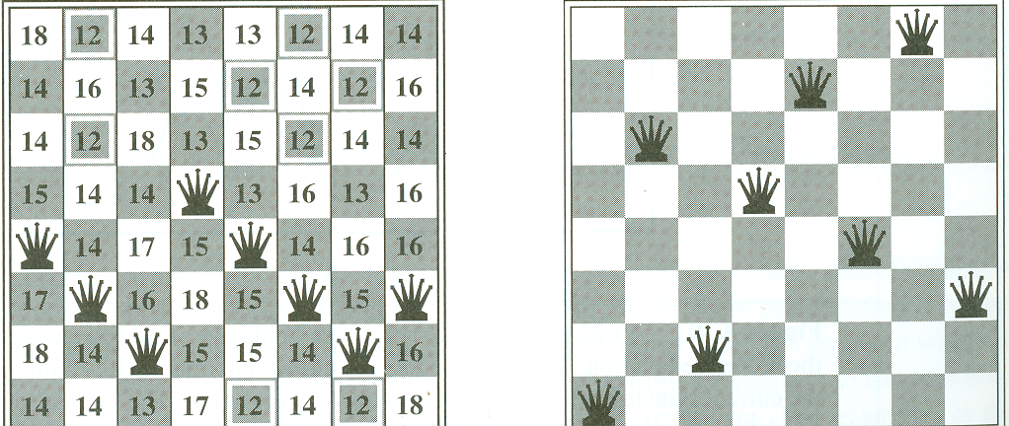
Hill Climbing: Neighborhood
Consider the 8-queen problem:
A State contains 8 queens on the board
The neighborhood of a state is all states generated by moving a single queen to another square in the same column (8*7 = 56 next states)
The objective function h(s) = number of pairs of queens that attack each other in state s (directly or indirectly).
h(s) = 17 best next is 12 h(s)=1 [local minima]
‹#›

Slide 25
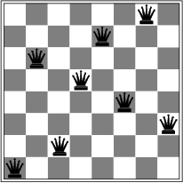
Hill Climbing Drawbacks
Local maxima/minima : local search can get stuck on a local maximum/minimum and not find the optimal solution
Cost
Local minimum
States
‹#›

Slide 26
Hill Climbing in Action …
Cost
States
‹#›

Slide 27
Hill Climbing
Current Solution
‹#›

Slide 28
Hill Climbing
Current Solution
‹#›

Slide 29
Hill Climbing
Current Solution
‹#›

Slide 30
Hill Climbing
Current Solution
‹#›

Slide 31
Hill Climbing
Best
Local Minimum
Global Minimum
‹#›

Slide 32
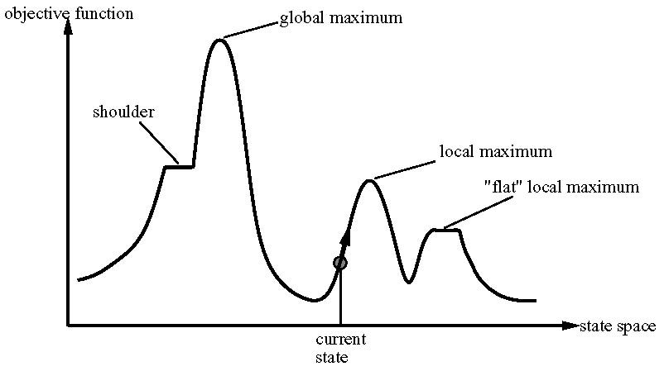
Local Search: State Space
A state space landscape is a graph of states associated with their costs
‹#›

Slide 33
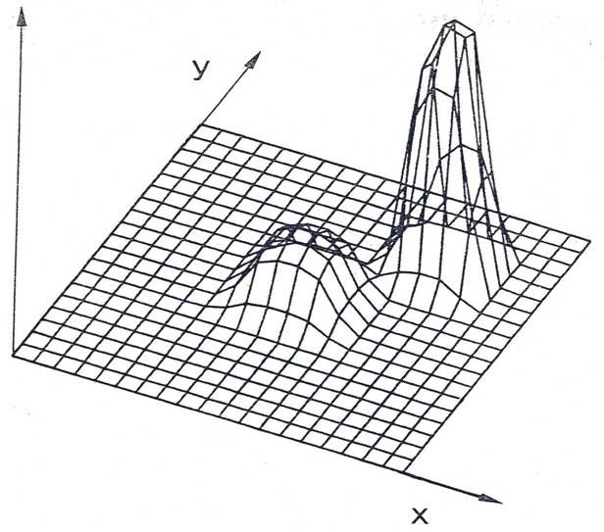
Issues
The Goal is to find GLOBAL optimum.
How to avoid LOCAL optima?
When to stop?
Climb downhill? When?
‹#›

Slide 34
Plateaux
A plateu is a flat area of the state-space landscape
‹#›

Slide 35
Sideways Move
Hoping that plateu is realy a shoulder
Limit the number of sideway moves, otherwise infinite loop
Example:
100 consecutive sideways moves for 8 queens problem
Chances increase form 14% to 94%
It is incomplete, because stuck at local maxima
‹#›

Slide 36
Random-restart hill climbing
Randomly generate an initial state until a goal is found
It is trivially complete with probability approaching to 1
Example:
For 8-quens problem, very effective
For three million queens, solve the problem within minute
‹#›

Slide 37
Local Search Algorithms
Simulated Annealing
(Stochastic hill climbing …)

Slide 38
Simulated Annealing
Key Idea: escape local maxima by allowing some "bad" moves but gradually decrease their frequency
Take some uphill steps to escape the local minimum
Instead of picking the best move, it picks a random move
If the move improves the situation, it is executed. Otherwise, move with some probability less than 1.
Physical analogy with the annealing process:
Allowing liquid to gradually cool until it freezes
The heuristic value is the energy, E
Temperature parameter, T, controls speed of convergence.
‹#›

Slide 39
Simulated Annealing
Basic inspiration: What is annealing?
In mettallurgy, annealing is the physical process used to temper or harden metals or glass by heating them to a high temperature and then gradually cooling them, thus allowing the material to coalesce into a low energy cristalline state.
Heating then slowly cooling a substance to obtain a strong cristalline structure.
Key idea: Simulated Annealing combines Hill Climbing with a random walk in some way that yields both efficiency and completeness.
Used to solve VLSI layout problems in the early 1980
‹#›

Slide 40
Simulated Annealing in Action …
Cost
Best
States
‹#›

Slide 41
Simulated Annealing
Cost
Best
States
‹#›

Slide 42
Simulated Annealing
Cost
Best
States
‹#›

Slide 43
Simulated Annealing
Cost
Best
States
‹#›

Slide 44
Simulated Annealing
Cost
Best
States
‹#›

Slide 45
Simulated Annealing
Cost
Best
States
‹#›

Slide 46
Simulated Annealing
Cost
Best
States
‹#›

Slide 47
Simulated Annealing
Cost
Best
States
‹#›

Slide 48
Simulated Annealing
Cost
Best
States
‹#›

Slide 49
Simulated Annealing
Cost
Best
States
‹#›

Slide 50
Simulated Annealing
Cost
Best
States
‹#›

Slide 51
Simulated Annealing
Cost
Best
States
‹#›

Slide 52
Simulated Annealing
Cost
Best
States
‹#›

Slide 53
Simulated Annealing
Cost
Best
States
‹#›

Slide 54
Simulated Annealing
Cost
Best
States
‹#›

Slide 55
Simulated Annealing
Cost
Best
States
‹#›

Slide 56
Simulated Annealing
Cost
Best
States
‹#›

Slide 57
Simulated Annealing
Cost
Best
States
‹#›

Slide 58
Simulated Annealing
Cost
Best
States
‹#›

Slide 59
Simulated Annealing
Cost
Best
States
‹#›

Slide 60
Simulated Annealing
Cost
Best
States
‹#›

Slide 61
Simulated Annealing
Cost
Best
States
‹#›

Slide 62
Simulated Annealing
Cost
Best
States
‹#›

Slide 63
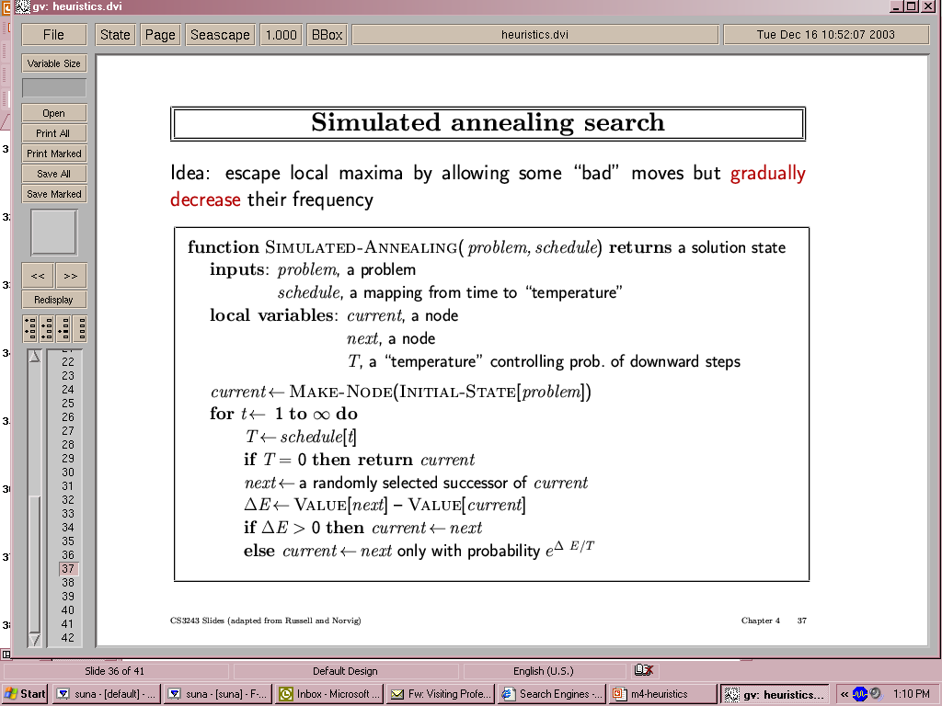
Simulated Annealing
‹#›

Slide 64
Simulated Annealing
Temperature T
Used to determine the probability
High T : large changes
Low T : small changes
Cooling Schedule
Determines rate at which the temperature T is lowered
Lowers T slowly enough, the algorithm will find a global optimum
In the beginning, aggressive for searching alternatives, become conservative when time goes by
‹#›

Slide 65
Simulated Annealing for TSP
Initial State
Permutation of numbers 1 … N
Where cities are numbered from 1 … N
Rearrangements for new states
2-swap, 3-swap, k-swap or any other
Energy i.e. heuristic function
Total distance
∆E = distance (current) – distance (next)
‹#›

Slide 66
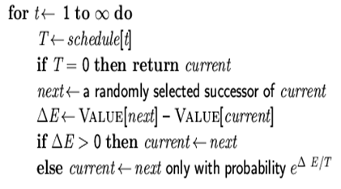
Simulated Annealing for TSP
Temperature T
Initially a value considerably larger than the largest ∆E normally encountered
Cooling Schedule
Determines rate at which the temperature T is lowered, say 10% decrease of T
Keep new value of T constant, say 100N reconfigurations or 10N successful reconfigurations
‹#›

Slide 67
Local Search Algorithms
Simulated Annealing
(hill climbing with small memory)

Slide 68
Tabu Search
The basic concept of Tabu Search as described by Glover (1986) is "a meta-heuristic superimposed on another heuristic.
The overall approach is to avoid entrainment in cycles by forbidding or penalizing moves which take the solution, in the next iteration, to points in the solution space previously visited ( hence "tabu").
The Tabu search is fairly new, Glover attributes it's origin to about 1977.
‹#›

Slide 69
Tabu Search Algorithm (simplified)
1. Start with an initial feasible solution
2. Initialize Tabu list
3. Generate a subset of neighborhood and find the best solution from the generated ones
4. If move is not in tabu list then accept
5. Repeat from 3 until terminating condition
‹#›

Slide 70
Tabu Search: TS in Action …
Cost
States
‹#›

Slide 71
Tabu Search: TS
Best
‹#›

Slide 72
Tabu Search: TS
Best
‹#›

Slide 73
Tabu Search: TS
Best
‹#›

Slide 74
Tabu Search: TS
Best
‹#›

Slide 75
Tabu Search: TS
Best
‹#›

Slide 76
Tabu Search: TS
Best
‹#›

Slide 77
Tabu Search: TS
Best
‹#›

Slide 78
Tabu Search: TS
Best
‹#›

Slide 79
Tabu Search: TS
Best
‹#›

Slide 80
Tabu Search: TS
Best
‹#›

Slide 81
Tabu Search: TS
Best
‹#›

Slide 82
Tabu Search: TS
Best
‹#›

Slide 83
Tabu Search: TS
Best
‹#›

Slide 84
Tabu Search: TS
Best
‹#›

Slide 85
Tabu Search: TS
Best
‹#›

Slide 86
Tabu Search: TS
Best
‹#›

Slide 87
Tabu Search: TS
Best
‹#›

Slide 88
Tabu Search: TS
Best
‹#›

Slide 89
Tabu Search: TS
Best
‹#›

Slide 90
Tabu Search: TS
Best
‹#›

Slide 91
Tabu Search: TS
Best
‹#›

Slide 92
Tabu Search: TS
Best
‹#›

Slide 93
Tabu Search for TSP
1. Start with an initial feasible solution
2. Initialize Tabu list, initially empty
A pair of nodes that have been exchanged recently
3. Generate a subset of neighborhood and find the best solution from the generated ones
4. If move is not in tabu list then accept
5. Repeat from 3 until terminating condition i.e. T = 0
‹#›

Slide 94
Optimization Problems
Population Based Algorithms
Beam Search, Genetic Algorithms & Genetic Programming

Slide 95
Population based Algorithms
Beam Search Algorithm

Slide 96
Local Beam Search
Idea: keep k states instead of just 1
Begins with k randomly generated states
At each step all the successors of all k states are generated.
If one is a goal, we stop, otherwise select k best successors from complete list and repeat
‹#›

Slide 97
Local Beam Search
Unlike Hill Climbing, Local Beam Search keeps track of k states rather than just one.
It starts with k randomly generated states.
At each step, all the successors of all the states are generated.
If any one is a goal, the algorithm halts, otherwise it selects the k best successors from the complete list and repeats.
LBS≠ running k random restarts in parallel instead of sequence.
Drawback: less diversity. → Stochastic Beam Search
‹#›

Slide 98
Local Beam Search
Cost
States
‹#›

Slide 99
Local Beam Search
‹#›

Slide 100
Local Beam Search
‹#›

Slide 101
Local Beam Search
‹#›

Slide 102
Local Beam Search
‹#›

Slide 103
Local Beam Search
‹#›

Slide 104
Local Beam Search
‹#›

Slide 105
Local Beam Search
‹#›

Slide 106
Local Beam Search
‹#›

Slide 107
Local Beam Search
‹#›

Slide 108
Local Beam Search
‹#›

Slide 109
Local Beam Search
‹#›

Slide 110
Local Beam Search
‹#›

Slide 111
Local Beam Search
‹#›

Slide 112
Local Beam Search
‹#›

Slide 113
Local Beam Search
‹#›

Slide 114
Genetic Algorithms
A variant of stochastic beam search

Slide 115
Genetic Algorithms - History
Pioneered by John Holland in the 1970’s
Got popular in the late 1980’s
Based on ideas from Darwinian Evolution
Can be used to solve a variety of problems that are not easy to solve using other techniques

Slide 116
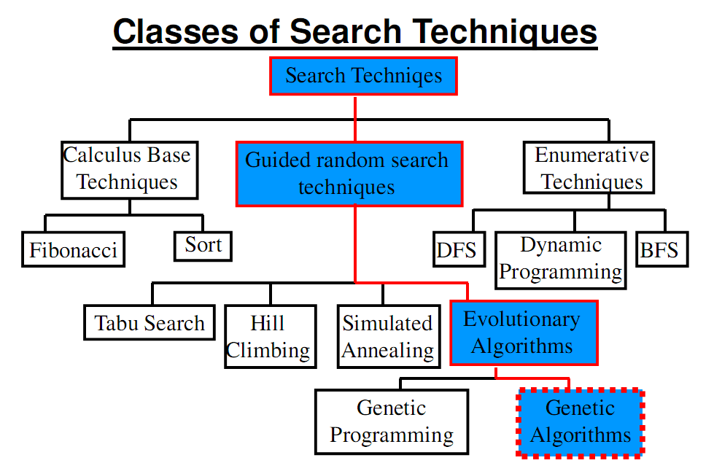

Slide 117
Evolution in the real world
Each cell of a living thing contains chromosomes - strings of DNA
Each chromosome contains a set of genes - blocks of DNA
Each gene determines some aspect of the organism (like eye colour)
A collection of genes is sometimes called a genotype
A collection of aspects (like eye colour) is sometimes called a phenotype
Reproduction involves recombination of genes from parents and then small amounts of mutation (errors) in copying
The fitness of an organism is how much it can reproduce before it dies
Evolution based on “survival of the fittest”

Slide 118
Start with a Dream…
Suppose you have a problem
You don’t know how to solve it
What can you do?
Can you use a computer to somehow find a solution for you?
This would be nice! Can it be done?

Slide 119
A dumb solution
A “blind generate and test” algorithm:
Repeat
Generate a random possible solution
Test the solution and see how good it is
Until solution is good enough

Slide 120
Can we use this dumb idea?
Sometimes - yes:
if there are only a few possible solutions
and you have enough time
then such a method could be used
For most problems - no:
many possible solutions
with no time to try them all
so this method can not be used

Slide 121
A “less-dumb” idea (GA)
Generate a set of random solutions
Repeat
Test each solution in the set (rank them)
Remove some bad solutions from set
Duplicate some good solutions
make small changes to some of them
Until best solution is good enough

Slide 122
Stochastic Search: Genetic Algorithms
GAs emulate ideas from genetics and natural selection and can search potentially large spaces.
Before we can apply Genetic Algorithm to a problem, we need to answer:
- How is an individual represented?
- What is the fitness function?
- How are individuals selected?
- How do individuals reproduce?
‹#›

Slide 123
How do you encode a solution?
Obviously this depends on the problem!
GA’s often encode solutions as fixed length “bitstrings” (e.g. 101110, 111111, 000101)
Each bit represents some aspect of the proposed solution to the problem
For GA’s to work, we need to be able to “test” any string and get a “score” indicating how “good” that solution is

Slide 124
Silly Example - Drilling for Oil
Imagine you had to drill for oil somewhere along a single 1km desert road
Problem: choose the best place on the road that produces the most oil per day
We could represent each solution as a position on the road
Say, a whole number between [0..1000]

Slide 125

Where to drill for oil?
Solution1 = 300
Solution2 = 900
Road
0
500
1000

Slide 126
Digging for Oil
The set of all possible solutions [0..1000] is called the search space or state space
In this case it’s just one number but it could be many numbers or symbols
Often GA’s code numbers in binary producing a bitstring representing a solution
In our example we choose 10 bits which is enough to represent 0..1000

Slide 127
Convert to binary string
 | 512 | 256 | 128 | 64 | 32 | 16 | 8 | 4 | 2 | 1
900 | 1 | 1 | 1 | 0 | 0 | 0 | 0 | 1 | 0 | 0
300 | 0 | 1 | 0 | 0 | 1 | 0 | 1 | 1 | 0 | 0
1023 | 1 | 1 | 1 | 1 | 1 | 1 | 1 | 1 | 1 | 1
In GA’s these encoded strings are sometimes called “genotypes” or “chromosomes” and the individual bits are sometimes called “genes”

Slide 128
Drilling for Oil
Solution1 = 300 (0100101100)
Solution2 = 900 (1110000100)
Road
0
1000
3
O I L
5
Location

Slide 129
Back to the (GA) Algorithm
Generate a set of random solutions
Repeat
Test each solution in the set (rank them)
Remove some bad solutions from set
Duplicate some good solutions
make small changes to some of them
Until best solution is good enough

Slide 130
Select a set of random population
No. | Decimal | Chromosome | Fitness
1 | 666 | 1010011010 | 1
2 | 993 | 1111100001 | 2
3 | 716 | 1011001100 | 3
4 | 640 | 1010000000 | 1
5 | 16 | 0000010000 | 3
6 | 607 | 1001011111 | 5
7 | 341 | 0101010101 | 1
8 | 743 | 1011100111 | 2

Slide 131
Roulette Wheel Selection
1
2
3
4
5
6
7
8
1
2
3
1
3
5
1
2
0
Rnd[0..18] = 7
Chromosome4
Parent1
Rnd[0..18] = 12
Chromosome6
Parent2
18

Slide 132
Other Kinds of Selection (not roulette)
Tournament
Pick k members at random then select the best of these
Different variations are there too
Elitism, etc.
Always keep at least one copy of the fittest solution so far
Linear ranking
Exponential ranking
Many more
‹#›

Slide 133
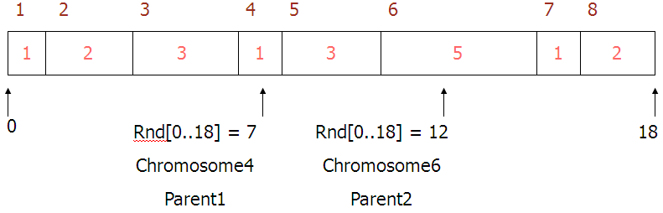
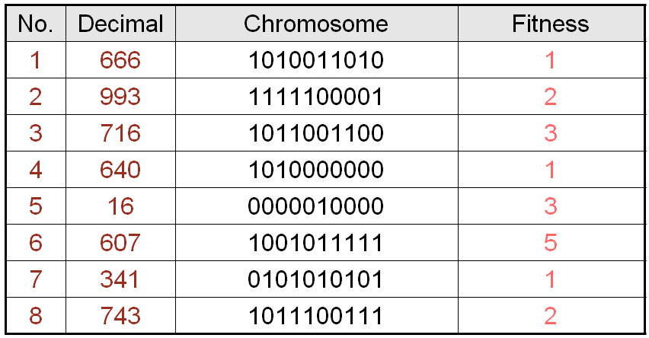
Crossover - Recombination
1010000000
Parent1
Offspring1
1011011111
1001011111
Parent2
Offspring2
1000000000
Crossover single point - random
With some high probability (crossover rate) apply crossover to the parents. (typical values are 0.8 to 0.95)

Slide 134
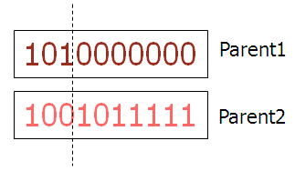
Variants of Crossover - Recombination
Half from one, half from the other: 0110 1001 0100 1110 1010 1101 1011 0101 1101 0100 0101 1010 1011 0100 1010 0101 0110 1001 0100 1110 1011 0100 1010 0101
Or we might choose “genes” (bits) randomly: 0110 1001 0100 1110 1010 1101 1011 0101 1101 0100 0101 1010 1011 0100 1010 0101 0100 0101 0100 1010 1010 1100 1011 0101
Or we might consider a “gene” to be a larger unit: 0110 1001 0100 1110 1010 1101 1011 0101 1101 0100 0101 1010 1011 0100 1010 0101 1101 1001 0101 1010 1010 1101 1010 0101
‹#›

Slide 135
Mutation
mutate
Offspring1
1011011111
Offspring1
1011001111
719
1000000000
Offspring2
1010000000
640
Offspring2
Original offspring
Mutated offspring
With some small probability (the mutation rate) flip each bit in the offspring (typical values between 0.1 and 0.001)

Slide 136
Drilling for Oil
Solution1 = 300 (0100101100)
Solution2 = 900 (1110000100)
Road
0
1000
3
O I L
5
Location

Slide 137
Drilling for Oil
Solution1 = 640 (1010000000)
Solution2 = 719 (1011001111)
Road
0
1000
1
3
O I L
5
6
Location

Slide 138
Back to the (GA) Algorithm
Generate a set of random solutions
Repeat
Test each solution in the set (rank them)
Remove some bad solutions from set
Duplicate some good solutions
make small changes to some of them
Until best solution is good enough

Slide 139
Genetic Algorithms in Action …
Cost
States
‹#›

Slide 140
Genetic Algorithms
Mutation
Cross-Over
‹#›

Slide 141
Genetic Algorithms
‹#›

Slide 142
Genetic Algorithms
‹#›

Slide 143
Genetic Algorithms
‹#›

Slide 144
Genetic Algorithms
‹#›

Slide 145
Genetic Algorithms
‹#›

Slide 146
Genetic Algorithms
‹#›

Slide 147
Genetic Algorithms
‹#›

Slide 148
Genetic Algorithms
‹#›

Slide 149
Genetic Algorithms
‹#›

Slide 150
Genetic Algorithms
‹#›

Slide 151
Genetic Algorithms
‹#›

Slide 152
Genetic Algorithms
‹#›

Slide 153
Genetic Algorithms
‹#›

Slide 154
Genetic Algorithms
‹#›

Slide 155
Genetic Algorithms
‹#›

Slide 156
Genetic Algorithms
‹#›

Slide 157
Genetic Algorithms
‹#›

Slide 158
Another Example: The Traveling Salesman Problem (TSP)
The traveling salesman must visit every city in his territory exactly once and then return to the starting point; given the cost of travel between all cities, how should he plan his itinerary for minimum total cost of the entire tour?
TSP ∈ NP-Complete
Note: we shall discuss a single possible approach to approximate the TSP by GAs
‹#›

Slide 159
TSP (Representation, Evaluation, Initialization and Selection)
A vector v = (i₁ i_{2…} i_{n}) represents a tour (v is a permutation of {1,2,…,n})
Fitness f of a solution is the inverse cost of the corresponding tour
Initialization: use either some heuristics, or a random sample of permutations of {1,2,…,n}
We shall use the fitness proportionate selection
‹#›

Slide 160
TSP (Crossover1)
OX – builds offspring by choosing a sub-sequence of a tour from one parent and preserving the relative order of cities from the other parent and feasibility
Example:
p₁ = (1 2 3 4 5 6 7 8 9) and
p₂ = (4 5 2 1 8 7 6 9 3)
First, the segments between cut points are copied into offspring
o₁ = (x x x 4 5 6 7 x x) and
o₂ = (x x x 1 8 7 6 x x)
‹#›

Slide 161
TSP (Crossover2)
Next, starting from the second cut point of one parent, the cities from the other parent are copied in the same order
The sequence of the cities in the second parent is
After removal of cities from the first offspring we get
This sequence is placed in the first offspring
o₁ = (2 1 8 4 5 6 7 9 3), and similarly in the second
o₂ = (3 4 5 1 8 7 6 9 2)
p₂ = (4 5 2 1 8 7 6 9 3)
9 – 3 – 4 – 5 – 2 – 1 – 8 – 7 – 6
p₁ = (1 2 3 4 5 6 7 8 9) and
p₂ = (4 5 2 1 8 7 6 9 3)
9 – 3 – 4 – 5 – 2 – 1 – 8 – 7 – 6
‹#›

Slide 162
Why does crossover work?
A lot of theory about this and some controversy
Holland introduced “Schema” theory
The idea is that crossover preserves “good bits” from different parents, combining them to produce better solutions
A good encoding scheme would therefore try to preserve “good bits” during crossover and mutation

Slide 163
Summary of Genetic Algorithm
We have seen how to:
represent possible solutions as a number
encoded a number into a binary string
generate a score for each number given a function of “how good” each solution is - this is often called a fitness function
Our silly oil example is really optimisation over a function f(x) where we adapt the parameter x

Slide 164
Optimization Problems
Genetic programming: GP

Slide 165
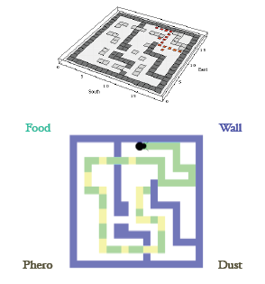
Genetic Programming
Genetic programming (GP)
Programming of Computers
by Means of Simulated Evolution
How to Program a Computer
Without Explicitly Telling It What to Do?
Genetic Programming is Genetic Algorithms where solutions are programs …
‹#›

Slide 166
Genetic programming
When the chromosome encodes an entire program or function itself this is called genetic programming (GP)
In order to make this work,encoding is often done in the form of a tree representation
Crossover entials swaping subtrees between parents
‹#›

Slide 167
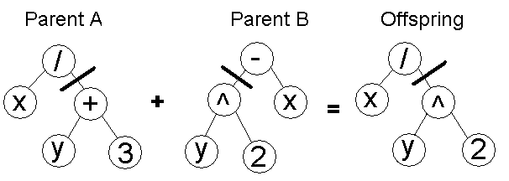
Genetic programming
It is possible to evolve whole programs like this but only small ones. Large programs with complex functions present big problems
‹#›

Slide 168
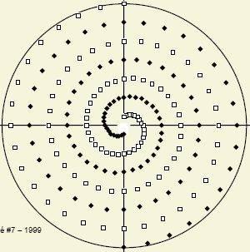
Genetic programming
Inter-twined Spirals: Classification Problem
Red Spiral
Blue Spiral
‹#›

Slide 169
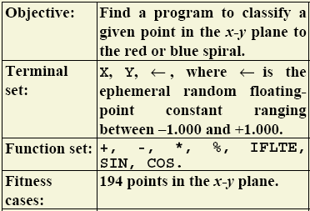
Genetic programming
Inter-twined Spirals: Classification Problem
‹#›

Slide 170
Optimization Problems
New Algorithms
ACO, PSO, QGA …

Slide 171

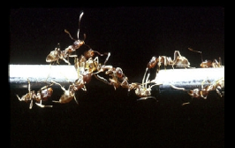
Anything to be Learnt from Ant Colonies?
Fairly simple units generate complicated global behaviour.
An ant colony expresses a complex collective behavior providing intelligent solutions to problems such as:
carrying large items
forming bridges
finding the shortest routes from the nest to a food source, prioritizing food sources based on their distance and ease of access.
“If we knew how an ant colony works, we might understand more about how all such systems work, from brains to ecosystems.”
(Gordon, 1999)
‹#›

Slide 172
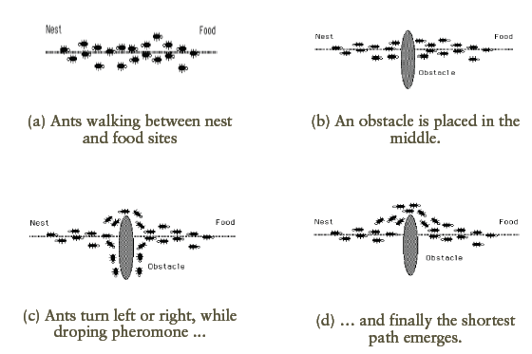
Shortest path discovery
‹#›

Slide 173
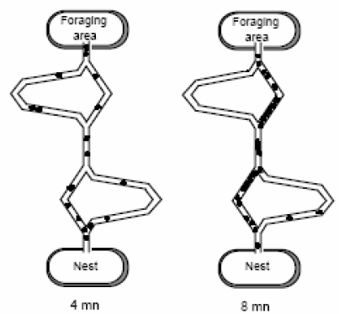
Shortest path discovery
Ants get to find the shortest path after few minutes …
‹#›

Slide 174
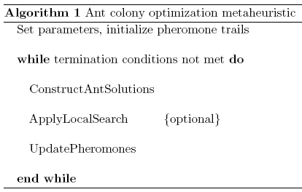
Ant Colony Optimization
Each artificial ant is a probabilistic mechanism that constructs a solution to the problem, using:
Artificial pheromone deposition
Heuristic information: pheromone trails, already visited cities memory …
‹#›

Slide 175
The sizes of the Traveling Salesman Problem
100,000 = 10⁵ people in a stadium.
5,500,000,000 = 5.5 × 10⁹ people on earth.
1,000,000,000,000,000,000,000 = 10²¹ liters of water on the earth.
10¹⁰ years = 3 × 10¹⁷ seconds = The age of the universe
# of cities n | possible solutions (n-1)! = # of cyclic permutations
10 | ≈ 181,000
20 | ≈ 10,000,000,000,000,000 = 10¹⁶
50 | ≈ 100,000,000,000,000,000,000,000,000,000,000,000,000,000, 000,000,000,000,000,000,000 = 10⁶²

Slide 176
Assignment 4
TSP with genetic algorithm
TSP with Ant Colony Optimization (ACO)
TSP with Bee Algorithm
‹#›

Slide 177
Summary
* Local search methods keep small number of nodes in memory.
They are suitable for problems where the solution is the goal state
itself and not the path.
* Hill climbing, simulated annealing and local beam search are
examples of local search algorithms.
* Stochastic algorithms represent another class of methods for
informed search. Genetic algorithms are a kind of stochastic hill-
climbing search in which a large population of states is
maintained. New states are generated by mutation and by
crossover which combines pairs of states from the population.
‹#›

Slide 178
References
Chapter 4 of “Artificial Intelligence: A modern approach” by Stuart Russell, Peter Norvig.
Chapter 5 of “Artificial Intelligence Illuminated” by Ben Coppin

